Slide 1
Lens for E - Learning
Under guidance of
Dr.B.Gopalakrishnan,
Asso Professor Department of Information Technology Bannari Amman Institute of Technology Sathyamagalam 638401
202IT156 – KISHORE ANANTH N
202IT206 – ROSHINI R S
202IT129 – DHARANIKUMAR A B

Slide 2
Abstract
In today's advancing technological world, students tend to learn skills, concepts very quickly and are also ready to face real-world problems. Traditional books are outdated; they don't update with the current trend.
The students get a limitation in learning. Here we have a solution to enhance their knowledge. We have created a model which can get an image input containing some snippets from a book or any reference. The model then extracts the text from the image. Analyze and get the keywords from the text. The best relevant content from the internet(Websites, Videos, references, etc.) is provided as the output with the help of keywords. Currently, there is no model in the market that gives personalized content for the students over a scan. Our model enhances students learning beyond books to different dimensions.

Slide 3
Problem Statement Addressed
Traditional books are outdated. Students need more than just books to enhance their knowledge. Internet serves as the best platform to learn, but also it is not reliable for students. Some moderation is to be done for narrowing the contents for learning. And also to save search time for students.

Slide 4
Existing Solution to the Problem Addressed
Google created models to scan over an image and provide the best search results. It is not personalized for students to learn. And also we are planning to provide it as a mobile application. So the user can learn within the application itself and also can store the information they like.

Slide 5
Proposed Solution to the Problem Addressed
Model is created to get an image input from the user. User can click an image from a book or some reference. It will be analysed and text will be extracted using OCR.
The raw text then analysed using NLP and will provide a summary.
The summary helps the user to understand the context easily.
From the summary keywords/Key phrases are extracted by understanding the content.(NLTK)
Model will automate google search with the keywords/ Key phrases available and return relevant top links to the user.
Model is deployed as a mobile application.

Slide 6
Proposed Solution to the Problem Addressed
The proposed solution reduce the internet search time for the students. Our model will automate the search and will provide all the relevant processed reference.
Summary provide a quick grasp of the content for the user.
With a good looking UI/UX the students will spend some ample time in our application.

Slide 7
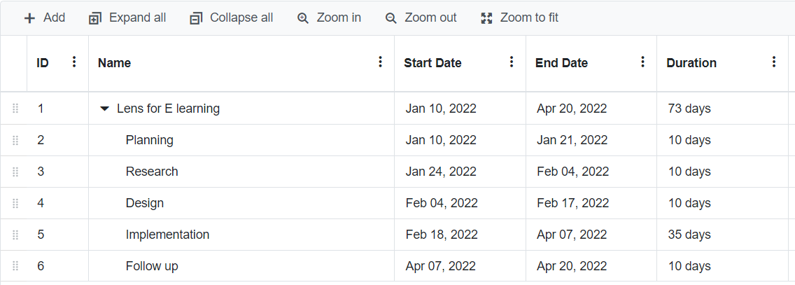
Project Work Plan

Slide 8
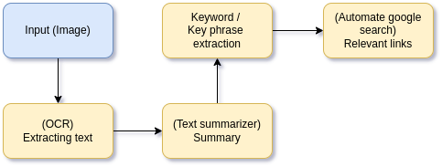
Block Diagram

Slide 9
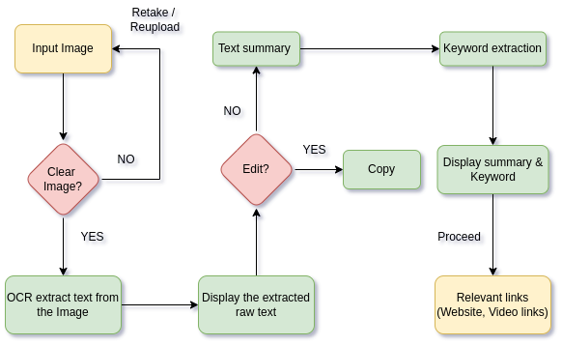
Flow Chart

Slide 10
Effective utilization of the Modern Tool & Cloud
Visual Studio Code
We used VS code for testing our python code in machine and to check the hardware(camera).
Google Cloud Platform(GCP)
Using GCP for cloud storage, and Firebase for managing database and hosting. We used firebase for ease of control over the backend services.

Slide 11
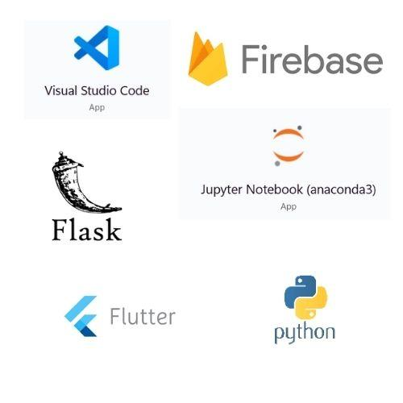
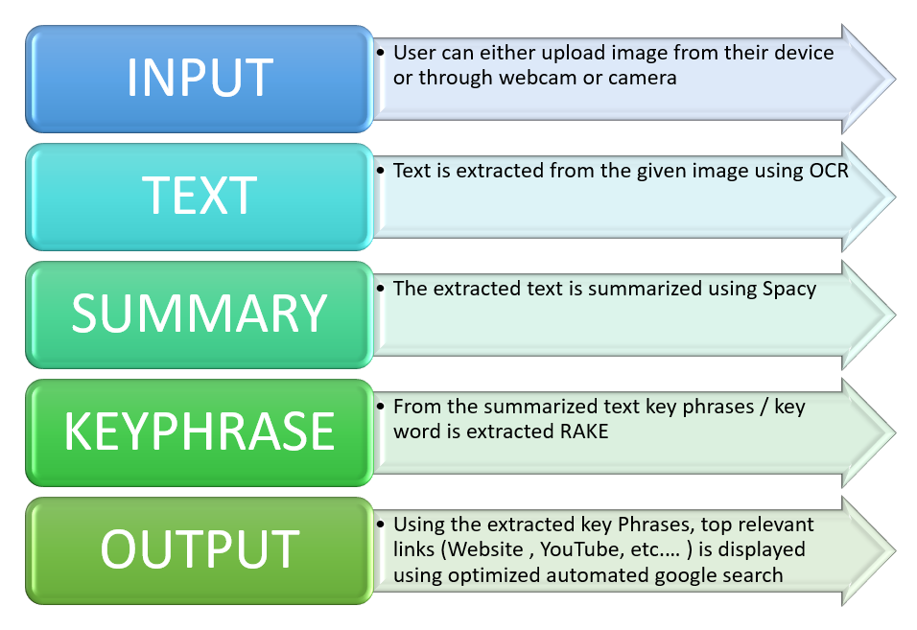
Technology stack Use case

Slide 12
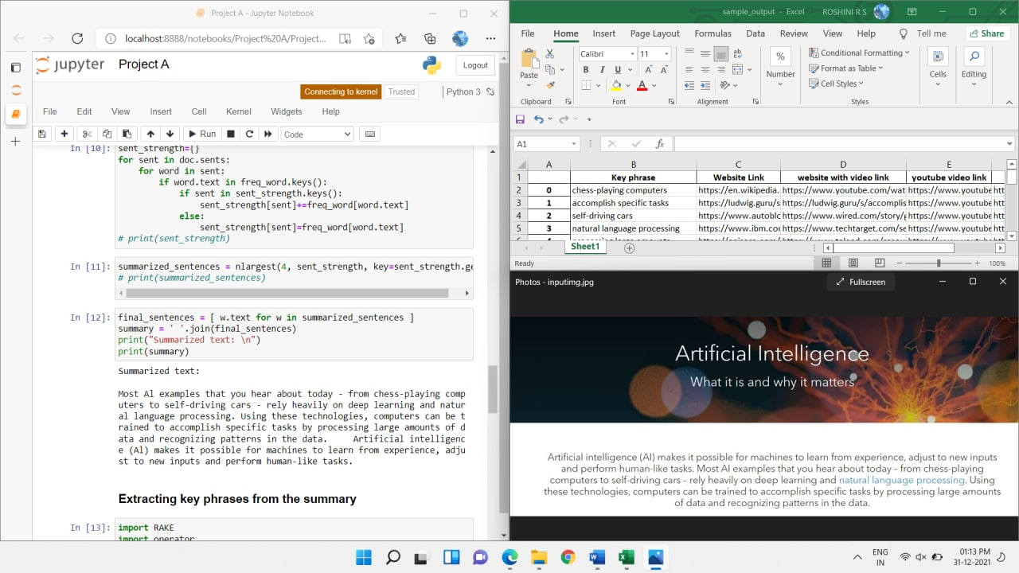
Prototype & Sample Output

Slide 13
Analysis of Results & Discussions
Analysis
Text summary and keywords/ Key phrases are displayed.
We obtained top relevant contents from the internet as user’s need from their input image.
Advantages
Save a huge amount of time for the user - Automated search
User gets all the relevant information within the application with good UI/UX.

Slide 14
Analysis of Results & Discussions
Disadvantage
While scrapping the internet for relevant links; broken and unauthorised links may also get scrapped.
Conclusion
Our model enhances students learning beyond books to different dimensions.
It also saves a lot of time for the users in learning.

Slide 15
Cost Benefit Analysis (List of Components / Service Used)
(Budget)
S.No | Component Name | Specification (IC number or Range or Value) | Unit Cost | Total Cost
1 | Firebase | - | 0 | 0
2 | Google cloud platform | - | Varying | Depends upon usage

Slide 16
Working video Link
https://drive.google.com/file/d/1nhkcMoYzPSvRAyZBjLRkxbxTpuPPeFAk/view?usp=sharing

Slide 17
References
https://stackoverflow.com/questions/34588464/python-how-to-capture-image-from-webcam-on-click-using-opencv
https://www.youtube.com/watch?v=JkzFjj2hjtw
https://www.geeksforgeeks.org/performing-google-search-using-python-code/

